Slide 1
CONGRATULATIONS!!
The purpose of this chapter shall be to create an enthusiasm for scholarship, to stimulate a desire to render service, to promote! Worthy leadership, and citizenship, and to encourage the development of character in students of Canton.

Slide 2
Required Elements
Juniors: 50 hours of Community Service
Seniors: 75 hours of Community Service
Minimum of 2 Leadership Roles
Character Ratings: teachers & coaches
Essay: 225 words or less
Join appropriate google classroom, if and only if, you plan on submitting an application.

Slide 3
Selection Process Rubric
Service:
Students must have made a significant and consistent contribution in some activity or organization (on a strictly volunteer basis) which promotes the idea of improving the quality of life for others.

Slide 4
Selection Process Rubric
Leadership:
Students must demonstrate that they have taken initiative to lead others, either by directing an activity or program or innovating some idea or concept either in school or within the community while in high school.

Slide 5
Selection Process Rubric
Character:
Students must demonstrate on a consistent basis maturity, sensitivity, high ethical/moral values, good sportsmanship, and above all, honesty.
Students should be a role model for other students in his/her daily conduct and attitude.

Slide 6
Membership Obligations
Dues; $25.00, $5.00 Shirt
Maintaining Standards/Pillars
Meetings
Chapter Service Project
Individual Service Projects: 10 hours
Monthly Community Service Projects
Friends on Friday
Other

Slide 7
Application Checklist
Student Activity Form (cover sheet):
student & parent/guardian name
Student Activity Chart: TYPED with advisor contact information
Service Activities
Leadership
Extracurricular
Previous Teachers
Essay
Addendum (if necessary)
Submitted to google classroom by October 28th at 9:00am
Senior google classroom code: lydh2zz
Junior google classroom code: e7nie6

Slide 8
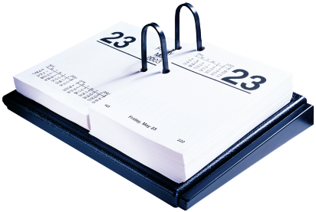
Important Dates: see “save the dates” for additional information
Application Due:
Wednesday, October, 28th
No later than 9:00am to googleclassrom
Decision Letters E-Mailed:
Seniors: Week of October 26th
Juniors: Week of November 2nd
Induction Ceremony:
TBD

Slide 9
Selection of Members
Faculty Council (selection committee) consists of five anonymous faculty members.
Chapter adviser shall be the sixth, nonvoting, member.
Review of Student Activity Chart and all requirements determines selection.
Completion of the cover page and chart does not guarantee selection.

Slide 10
Questions & Answers
Chart is adjustable
Individual rows can be enlarged
Currently there is no word count limit
Must have contact information
Proofread for grammar, spelling, etc.
MUST BE TYPED!
Transfer Students: see me

Slide 11
Changes made during 2020-2021 school year
Eligibility letters and selection letters will be e-mailed.
Seniors will be notified first, then juniors.
Community service hours were adjusted
Do not need to access signatures. Advisor name and contact information will replace this.
Informational Sessions will be conducted via zoom, there are three options. All optional.
Applications will be submitted via google classroom
Seniors: lydh2zz
Juniors: e7nie6
Essay

Slide 12
Advisor Information
Mrs. Blake
blakek@cantonma.org
781-821-5050 x 2610
CHS classroom 118
Please contact me with any questions you may have about the process and/or additional clarification.
Best Regards, Mrs. Blake

